Slide 1


Analysis of smoking status impact on molecular mechanisms of SARS-CoV-2 viral entry through single-cell sequencing experiments
Author: Mateusz Urbanek
Supervisor: PhD Anna Papież
Consultant: PhD Michał Marczyk
Notes:
Hello. My name is Mateusz Urbanek and the title of my thesis is Analysis of smoking status on molecular mechanisms of SARS-COV-2 viral entry through single-cell sequencing experiments. Supervisor of my thesis was Doktor Anna Papież, and the consultant of the work was Doktor Michał Marczyk.

Slide 2

01
Introduction
What is Single Cell data, and why is it important?
02
Research background and motivation
Table of contents
Why this topic was selected?
03
Workflow methodology
How did I approach analysis of Single Cell data?
04
Results Discussion
What can be concluded from the analysis?
Notes:
The presentation will consist of 4 parts:
First, I will have brief theoretical introduction to the topic.
Then I will talk about research background and motivation.
Next, there will be brief description of workflow methodology.
And finally, I will talk about the results.

Slide 3
01
Introduction
What is Single Cell data, and why is it important?
Notes:
Let’s start with introduction.

Slide 4
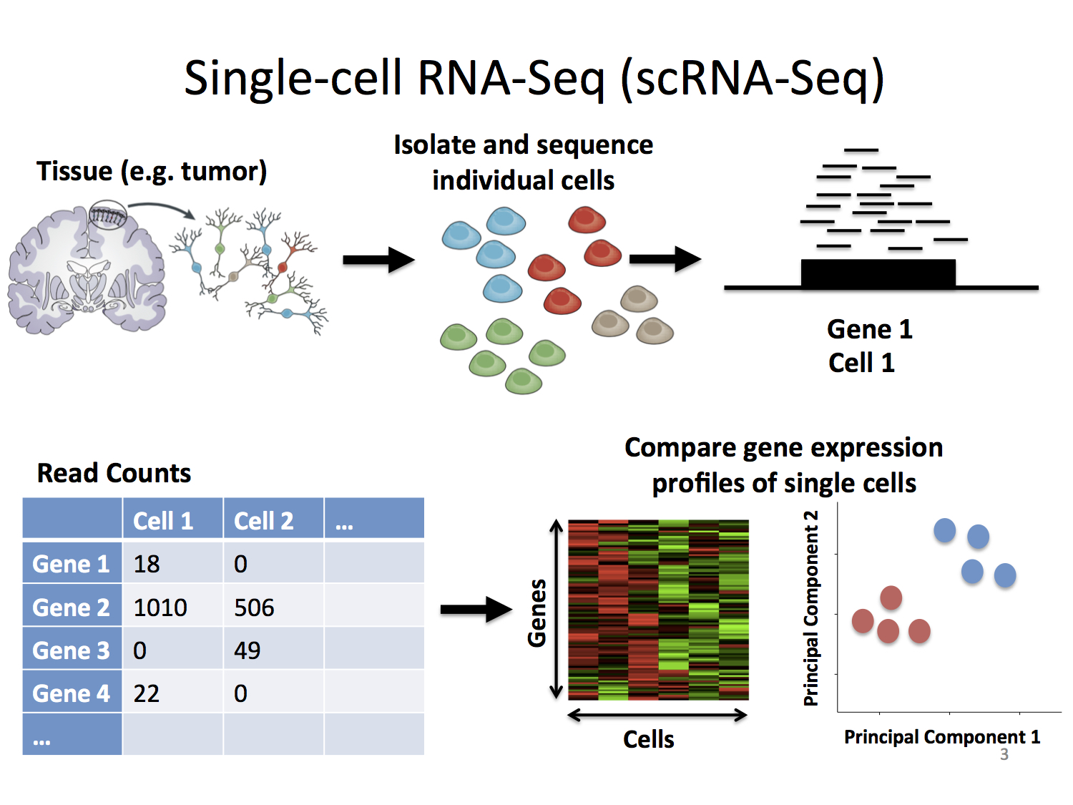
01 - Introduction
Single Cell RNA-seq
RNA sequencing (RNA-seq) - genomic approach for the detection and quantitative analysis of messenger RNA molecules in a biological sample and is useful for studying cellular responses.
Single Cell RNA sequencing (scRNA-seq) - cell are sorted then RNA-seq is performed on specific cell types separately.
Stephanie Hicks Welcome to the World of Single-Cell RNA-Sequencing https://speakerdeck.com/stephaniehicks/welcome-to-the-world-of-single-cell-rna-sequencing?slide=3
Notes:
RNA sequencing is a genomic approach for the detection and quantitative analysis of messenger RNA molecules in a biological sample. It is useful for studying cellular responses. Single Cell RNA-seq differs from RNA-seq, with how cells are treated in the initial part of workflow. The cells are sorted, and the RNA-seq is performed on specific cell types separately.

Slide 5
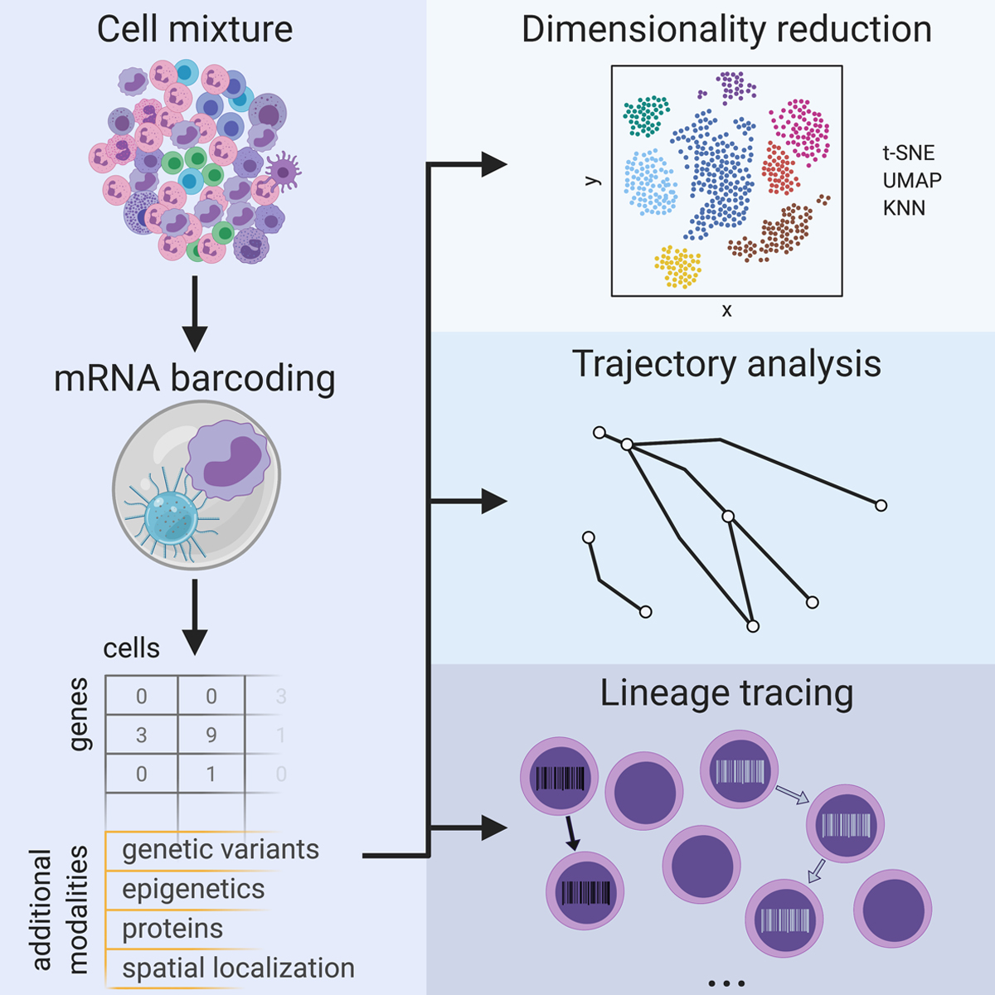
01 - Introduction
Why we need Single Cell RNA-seq?
Single-cell RNA sequencing (scRNA-seq), for example, can reveal complex and rare cell populations, uncover regulatory relationships between genes, and track the trajectories of distinct cell lineages in development.
Jean Acosta, Daniel Ssozi and Peter van Galen
Single-Cell RNA Sequencing to Disentangle the Blood System
https://www.ahajournals.org/doi/10.1161/ATVBAHA.120.314654
Notes:
Single-cell RNA sequencing can reveal complex and rare cell populations, uncover regulatory relationships between genes and track the trajectories of distinct cell lineages in development.

Slide 6
02
Research background and motivation
What is the impact of smoker’s status on SARS-COV-2
Notes:
Now I will describe research background.

Slide 7
02 - Research background
Data sets
Classic scRNA-seq analysis of the SARS-CoV-2 data
Single-cell analysis identifies shared and distinct immune features of COVID-19, Influenza and other community-acquired pneumonia
https://doi.org/10.7554/eLife.69661
Comparative analysis of the results of scRNA-seq SARS-CoV-2/Pneumonia and partially public data processed in the meta analysis.
Integrated analyses of single-cell atlases reveal age, gender, and smoking status associations with cell type-specific expression of mediators of SARS-CoV-2 viral entry and highlights inflammatory programs in putative target cells
https://doi.org/10.1101/2020.04.19.049254
Notes:
There were two most important publications and data sets, that I used during my analysis. The first one was used as the main dataset, on which the analysis was performed. It included COVID-19, influenza and community acquired pneumonia data. Thanks to the people from University of Malta, I also received additional metadata, describing smoking status of patients. The second data set was only partially public. It was used for comparative analysis with the first data set.

Slide 8
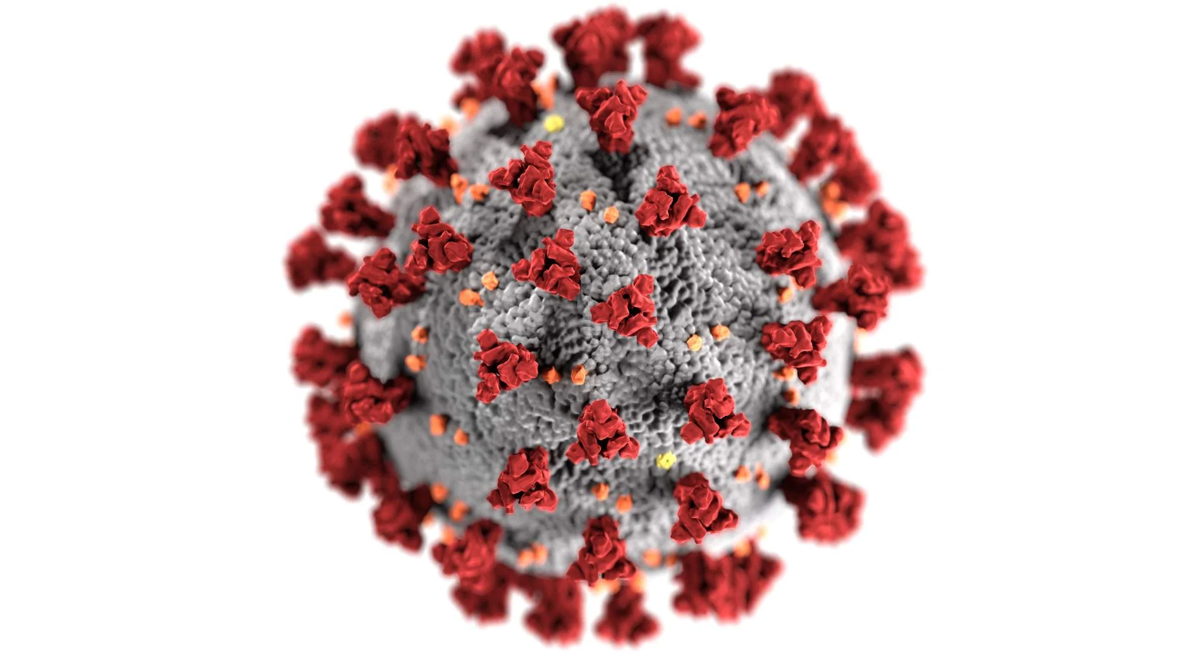
02 - Research background
Why this topic?
Huge research potential
There will be more and more data in the future
Personal reasons – family member (smoker) suffered complications after COVID-19
Notes:
Why was this topic selected by me? This topic has a huge research potential. There will be more and more data in the future, so the analysis can be expanded, and more precise conclusions can be drawn. There are not many publications concerning this topic. Additionally, there were personal reasons – a member of my family, who was a smoker, suffered complications after COVID-19. I thought it is important to at least try to understand this topic .

Slide 9
03
Workflow methodology
How did I approach analysis of Single Cell data
Notes:
Workflow methodology.

Slide 10
03 – methodology
Workflow
1. Quality assurance, scaling and normalization
2. Variance analysis, variable gene detection
3. Clustering and annotation
4. Results interpretation
Notes:
First, quality assurance, scaling and normalization of data was performed. Then I performed variance analysis and detected variable genes. After that, clusters were detected and annotated using reference based annotation algorithm. Finally I performed results interpretation.

Slide 11
04
Results discussion
What can be concluded from the analysis?
Notes:
Now I want to discuss the results.

Slide 12
04 – Results
Clustering and Annotation
Notes:
The annotation was performed on six different levels of accuracy. This results present the sixth, finest level of annotation. I started from presenting the predicted clusters on UMAP. The plot is divided into two sub plots. Cells coming from Non-smokers are presented on the left side and cells coming from the Smokers are presented on the right. There were seven clusters detected and annotated during this step.

Slide 13
04 – RESULTs
Molecules detected per cluster
Notes:
The cells in the dataset were annotated by professionals. This allowed me to verify accuracy of annotation prediction. There was higher number of clusters annotated by the professionals, but that’s due to the fact that CD4 and CD8 T-cells and B-cells are further divided into the sub groups. As we can observe on the violin plot, at this point the Non-classical Monocytes annotated by specialists were visible only in the smokers group.

Slide 14
04 – RESULTs
Annotation vs Prediction
Notes:
This look up table presents the performance of the annotation. As we can observe, in most cases the cells are classified as correct groups. However there are some NK Cells annotated as CD8 T-Cells.

Slide 15
04 – RESULTs
Marker genes distribution between smokers and non-smokers
Notes:
On the violin plots, I presented only most variable genes. As we can observe there is some disproportion in expression level, especially for the last two clusters non-classical monocytes, and Plasmacytoid DCs.

Slide 16
04 – RESULTS
Marker genes distribution between smokers and non-smokers (cont.)
Notes:
This is the continuation of the previous graph. We can see further disproportions, once again mostly in the non-classical monocytes cluster.

Slide 17
04 – RESULTS
Marker genes selected in another publication
Integrated analyses of single-cell atlases reveal age, gender, and smoking status associations with cell type-specific expression of mediators of SARS-CoV-2 viral entry and highlights inflammatory programs in putative target cells
https://doi.org/10.1101/2020.04.19.049254
Notes:
The data set used for comparison presented only 27 genes. Out of them, only 6 were present in the final stage of my analysis. As we can see on the Violin Plots, once again there were disproportion in expression levels of those genes in the clusters mentioned above. Additionally CTSS gene displayed increased level of expression for smokers among B-cells, and IL6ST gene among CD4 T-Cells.

Slide 18
05
Thank you for attention
Notes:
That’s the end of my presentation. Thank you for your attention.

